Slide 1


Slide 2

#LifeKoKaroLift
SGC Coaching:
Session 16
Mentoship call discussion

Slide 3
Agenda
Job Search Strategy–(40 mins)
Personalized Feedback–(30 mins)
How to hunt better opportunities
Attract the target recruiters
Proof Of Concept (POC) Guidance
Action Plan Review : (20 mins)
Status update on action plan and help needed

Slide 4
Takeaways from the mentorship
01
Status of Action Items
Action Items discussed till now
What efforts have you taken?
02
Let’s strategise !
Identify 4-5 companies to target
Derive your Job Search strategy
Customize your resume to the profile you are targeting, leverage Linkedin and your network
03
Bridging the gap
Identify the gap in skills required to crack the interview
How to move forward and bridge these gaps ?
04
Take up a Program Related Project in your organisation and try increasing the Project portfolio for hands on learning!
Discussing the Business Problem and breaking it down into a solvable technical problem.
Hands on Experience
05
Summary
Summarising the next steps to achieve the best outcomes !

Slide 5

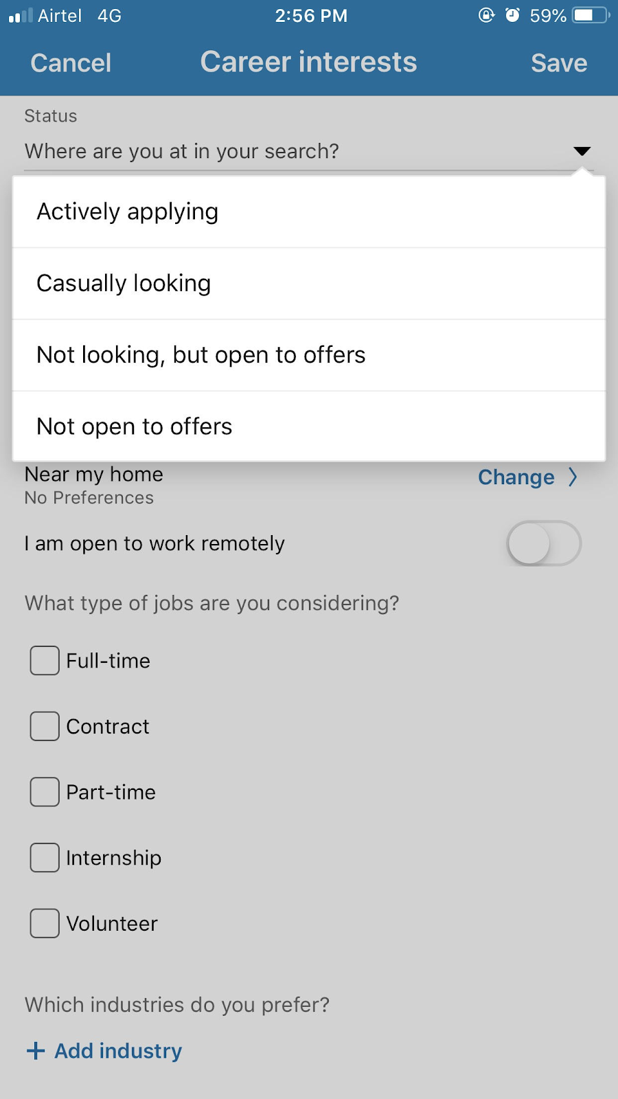
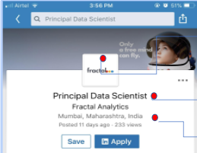


Job Search Strategy | Dos And Don’ts
Do’s
Prepare well before applying to open position with thorough research.
Stay open to market and keep your job search active.
Mark your career status for the recruiters and update profile regularly
Leverage your network and increase the effectiveness of your search hit rate.
Don’t’s
Apply with zero knowledge about company’s work and JD.
Send your profile to your network in bulk without customizing.
Apply for Open position on various portals
Mark Your career status on LinkedIn
Follow Industry Leaders to know if they are ‘hiring’
Enhance your network for Referral

Slide 6
Job Search Strategy | Tip And Tricks
Build your network of prospective recruiting agents to connect and explore relevant opportunities in the marketspace.
Don’t randomly add people in your network. Read through their profile, observe their journey, have clear reason why you are sending ‘connection request’ to them.
Personalized Message:
“Hello Mr/Ms. …,
I want to build my professional network and connect with the leaders in the Data Science area. I would like to introduce myself as [Brief introduction]. I have gone through your profile [Highlight a few points] and am really keen to join your network.
Looking forward to connecting with you. Thanks a lot!”
Run through the interviews to boost your learning and confidence, build network with top leaders, and learn about the compensation benchmark in the market. You can also pick certain question banks to work on skills.

Slide 7



Personalized Discussion | Project Portfolio Finalize Problem statement & Discuss Next steps
Have you chosen POC topic as per Mentor’s recommendation?
Yes.
No
Discuss Potential concerns
Can’t think of a valid use case.
Data / resource availability
Any hindrances from seniors?
POC Approach
Elaborate your method and if you are facing any issues in approach for the POC?
Expected outcome?
N
What’s next?
Steps to complete the POC
Accuracy and final insights
Present your solution effectively to the right stakeholders.
Things to remember:
POC must be chosen in line with Career outcomes & Track.
POCs enable you to showcase the skills and build confidence in your credentials.
Notes:
Learners are expected to have finalized the topic at least.
In terms of feedback, discuss the POC approach and expected outcome and related details with the learners.

Slide 8
Possible options to consider from external sources
Internships with relevant companies (e.g. Markytics ML internship)
Connect with industry leaders and engage in projects with them
Scout Internship platforms to find relevant opportunities
Projects:
Within your company or department, reach out to managers
E.g. Flipkart - Ecommerce marketing- Personalized Recommendation Engine
Outside your current organization, reach out to relevant colleagues to source opportunities.
Freelancing (e.g. https://www.freelancer.com)
Scout the market for the projects available
Sign contracts and decide a relevant rate
Increase engagement and dependency by delivering quality work

Slide 9



Tips to Choose your Project For POC
Check the criticality of the project and Its relevance to leadership team?
Check how is the project going to establish your proficiency in new techniques/ skills, i.e. upgrading skill repertoire
Self –Evaluation of your current knowledge to complete a project

Slide 10
Project Examples To Consider
Marketing
Objective: Personalized Marketing
Background: This is a system used by retailers to integrate personalized recommendations based on their users browsing history, past purchases, likes, and dislikes. It also lets retailers create highly targeted campaigns that increase ROI.
Challenge: All this is possible if retailers have data and they have the ability to extract meaningful insights from it.
Resources:
https://data-flair.training/blogs/data-science-in-retail/
https://github.com/Prakhar-FF13/Customer-Analytics
Ecommerce
Objective: Dynamic pricing
Background: Company wants to improve its pricing mechansim and adapt to competitive scenario by offering most attractive pricing on a sustained basis using Machine Learning and improve your KPI. The intent is to continuously learn from new information and detect new demands and trends.
Challenge: Create ML algorithm which is able to detect the new patterns ongoing and build dynamic pricing system.
Resources:
https://addepto.com/best-machine-learning-use-cases-ecommerce/
https://www.kaggle.com/viveknium/dynamic-pricing-with-feature-engineering
Source Use cases: Dr Rao

Slide 11


Action Plan: Status Update & Feedback
Track your progress
What is the progress on steps as discussed in first mentorship call?
What challenges did you face?
Plan to expedite if needed.
Recommendation
Action plan as discussed in the previous mentorship call
How can you develop on these ideas?
Share if any help needed
Notes:
Learner to update progress on the actions aligned with mentor.
Discuss the next set of activities as per their discussion with mentor.

Slide 12
Machine Learning Challanges
Experimentation
Matric Tracking
Source Control
Checkpoint Steps
Automate Deployment

Slide 13
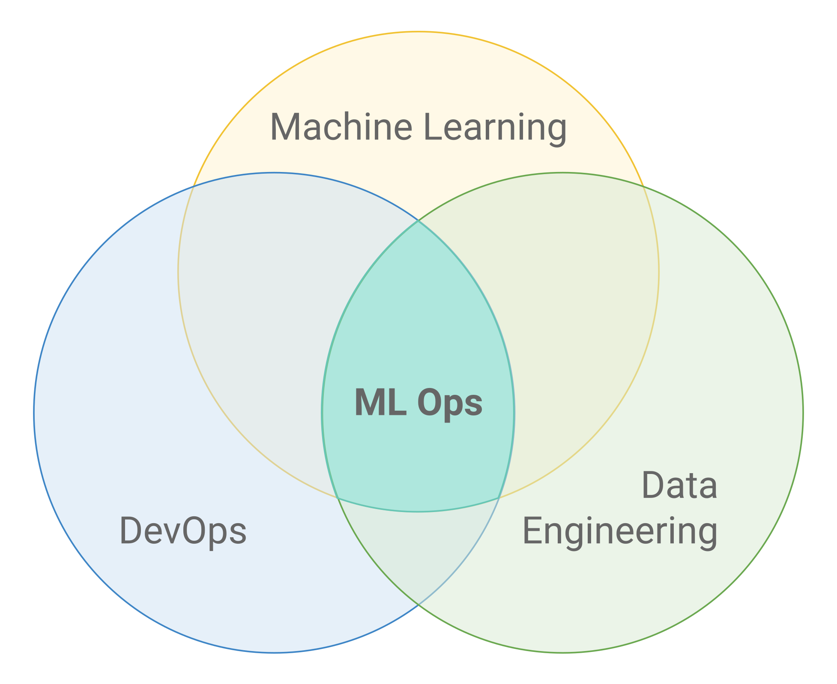
Focus Teaching: MLOps
ML is not just code, it’s code plus data
Notes:
Start with theme of how to show accountability and take initiatives and accepting your mistakes to take corrective actions

Slide 14
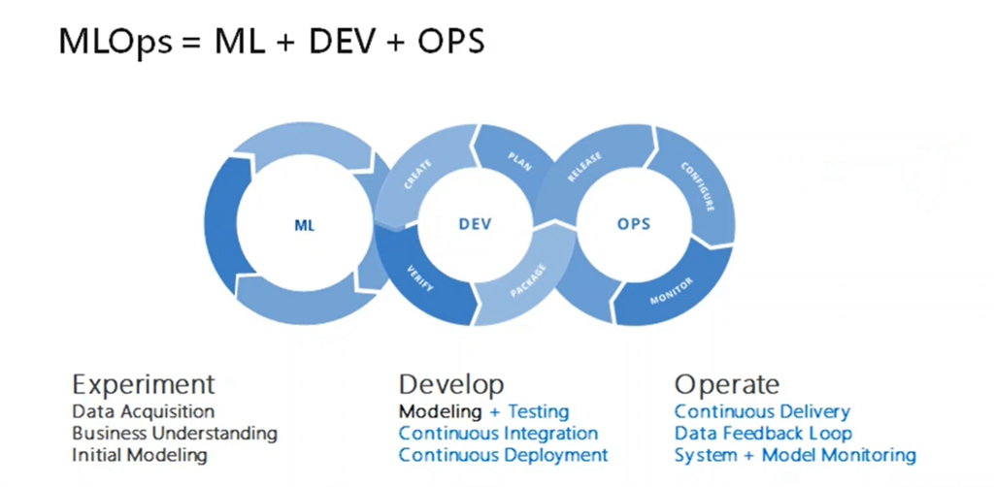
Focus Teaching: MLOps
Notes:
Start with theme of how to show accountability and take initiatives and accepting your mistakes to take corrective actions

Slide 15
Focus Teaching: MLOps
Data Science Steps
Data extraction
Data analysis
Data preparation
Model training
Model evaluation
Model monitoring
Model validation
Model serving

Slide 16
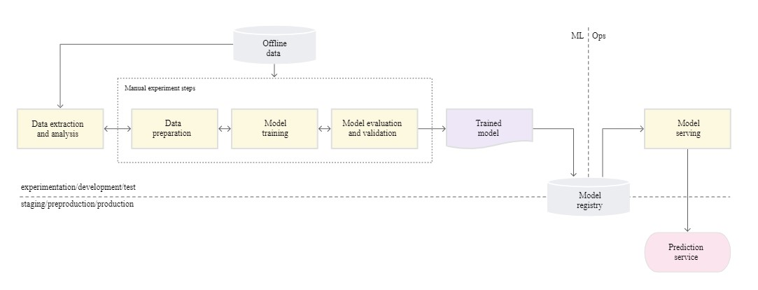
Focus Teaching: MLOps-level-0

Slide 17
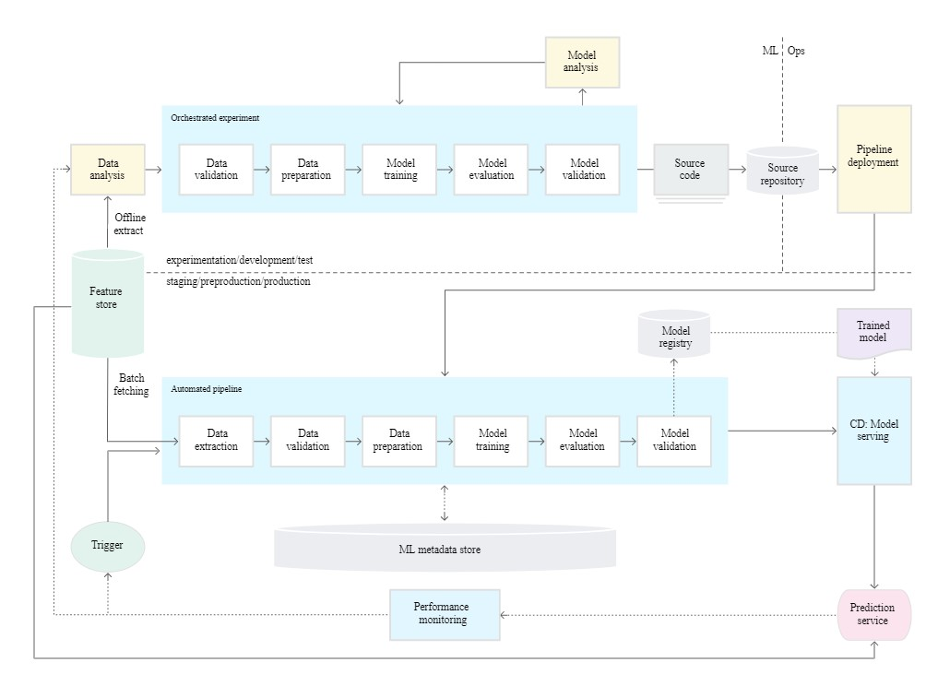
Focus Teaching: MLOps-level-1

Slide 18
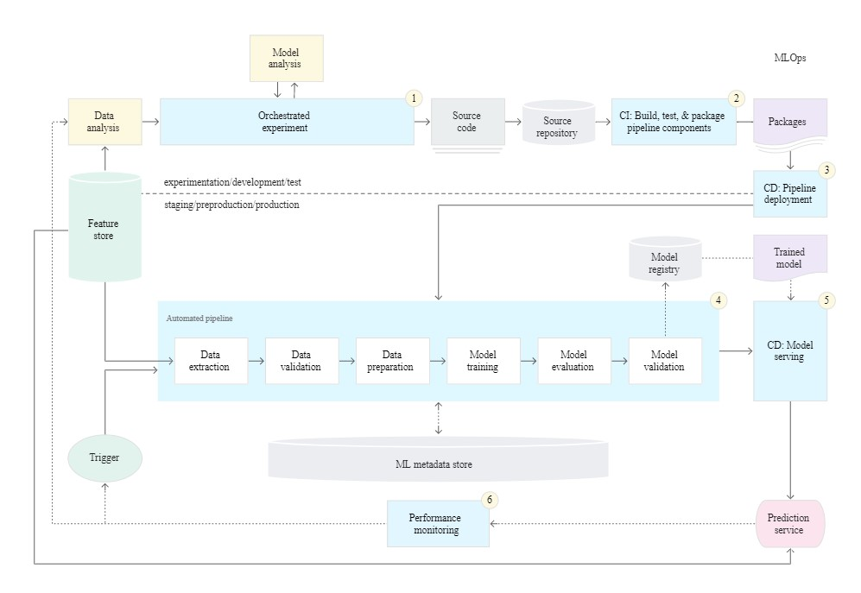
Focus Teaching: MLOps-level-2

Slide 19
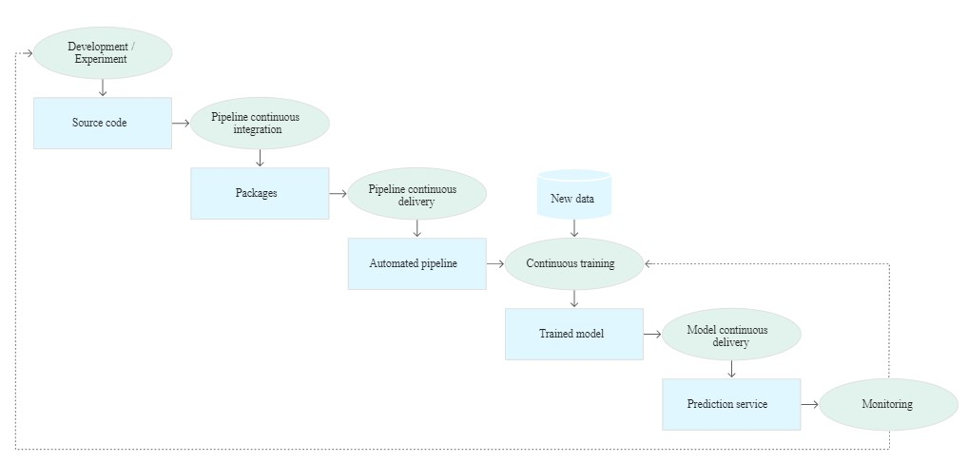
Focus Teaching: MLOps-level-2

Slide 20

Common Questions?
Doubts:
Action plan related issues
Job Hunt related concerns
How to identify right network in line with expected role?
Profile review
Any individual concern?

